Slide 1
Zigbee

Slide 2
Zigbee
Bluetooth IEEE 802.15.1 is not suitable for the unique needs of sensor and control devices.
IEEE 802.15.4 standard adopted a generic approach to meet the challenges of wireless sensor networks.
The motivation behind this approach was to address the control and monitoring requirements of
smart homes and hospitals,
industrial automation,
ship navigation,
weather prediction,
crop and habitat monitoring, and
security and surveillance management.

Slide 3
Summary of ZigBee, Bluetooth
 | ZigBee | Bluetooth
Standard | 802.15.4 | 802.15.1
Focus | Control and monitoring | Cable replacement
Basic N/W size | 255/65535 | 8
Maximum packet size | 4–32kB | >250kB
Number of channels | 27 | 79
Baseband (kb/s) | 20–250 | 710
Spreading | DSSS | FHSS
Topology | Ad hoc | Ad hoc
Architecture | Star, Tree, Cluster | Star
Protocol | CSMA/CA | Pt to Multi Pt
Trafﬁc type | Text | Text, Audio, Compressed Video
Battery life | Years | Days
Success matrics | Reliability, low power, low cost | Low cost, low latency, convenience
Application | Sensor network | Consumer electronics, cell phones

Slide 4
Zigbee
ZigBee provides supports low range wireless personal area network.
The power consumption of a ZigBee chip is very low. In fact, at this level of consumption, a AAA battery can last for a year.
ZigBee devices spend most of time in snoozing, and thus have very low duty cycles.
It uses a simple protocol stack compared to Bluetooth.

Slide 5
IEEE 802.15.4
IEEE 802.15.4 is the standard for 2.4GHz low power, low date rate wireless embedded communication system.
Some of the features of this standard are:
Supports data transfer rates between 20–250 kbps.
Supports 128-bit AES encryption.
Uses CSMA for channel sharing, and has provisions forMAC level acknowledgements for reliability.
Supports both long (64-bit) and short (16-bit) addressing modes with unicast and broadcast capabilities.
Supports maximum payload of 127 bytes in physical layer.
Only 72–116 bytes available for payload after MAC layer framing.

Slide 6
ZigBee Protocol Stack
The full ZigBee protocol stack is a combination of IEEE 802.15.4 PHY,MAC along with network, security and application protocols made available through ZigBee alliance.
In other words, ZigBee leverages IEEE 802.15.4 specification for WPAN at the two lowest layers, viz., PHY and MAC.
Network (NWK), and Application (APL) layers are defined by ZigBee standards as shown in Fig.1.

Slide 7
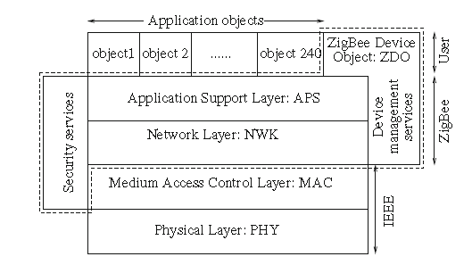
ZigBee Protocol Stack
Fig. 1 ZigBee protocol stack

Slide 8
ZigBee Protocol Stack
Though the responsibility for application development rests on the user,
ZigBee alliance developed specification for some application profiles in areas such as
smart energy,
Home automation,
telecom applications,
plant monitoring,
commercial building automation, and
health care.

Slide 9
ZigBee Protocol Stack: Physical Layer Responsibilities
Besides transmitting and receiving packets across the physical medium, the physical layer (PHY) is responsible for
the activation and the deactivation of radio transceiver,
energy detection,
link quality indication,
channel selection,
clear channel assessment.

Slide 10
ZigBee Protocol Stack: Physical Layer Responsibilities
PHY is based on Direct Sequence Spread Spectrum, operating on two frequency bands, namely, 2.4GHz, and 868–915MHz.
The data rates offered at these bands are 250Kbps for 2.4GHz and 40Kbps at 915MHz and 20Kbps at 868MHz.
Low data rates at low frequency provide lower propagation losses and longer range.
A total of 27 channels are available over three unlicensed bands:
(i) 16 in 2.4GHz band, (ii) 1 in 868.3MHz, and (iii) 10 in 902– 928MHz.

Slide 11
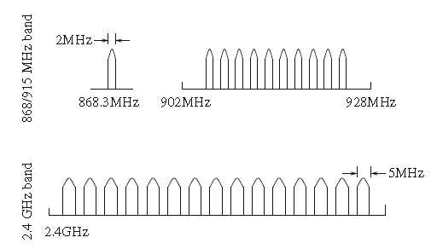
ZigBee Protocol Stack: Physical Layer Responsibilities
Figure 2 illustrates the channels availability in the three operating frequency bands
Fig. 2 Channels in three operating frequency bands

Slide 12
ZigBee Protocol Stack: MAC Layer
MAC layer employs 64-bit IEEE and 8-bit short addressing.
Short addressing is used for ad hoc network IDs.
Theoretically, ultimate network size could be as large as 2^64 with long addressing;
and in most case this is more than what may be needed for building a smart environment .
Even with 8-bit local addresses, the network size can be of 255 nodes,
which is also more than the requirements involving a personal area networking in most cases.

Slide 13
ZigBee Protocol Stack: MAC Layer
Three classes of devices are supported, namely,
1. Reduced Function Device (RFD),
2. Full Function Device (FFD), and
3. Network Coordinator.
Each ZigBee device is mapped to one of three classes RFD, FFD and N/W coordinator. RFDs operate in snooze mode, and wake up infrequently for sending data, then go back to sleep.
ZigBee supports three different network topologies: mesh, tree and star.

Slide 14
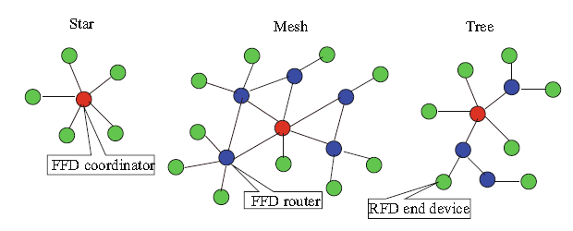
ZigBee Protocol Stack: MAC Layer
A star network is a 1-hop network, where all devices are connected to the coordinator FFD.
In a mesh network, a RFD node is connected to a FFD which routes data to and from the coordinator.
For a tree topology the coordinator is at the root and end devices
may communicate with the coordinator either directly or through a router
Fig. 3 ZigBee network topologies

